Slide 1

COST-EFFECTIVE
COASTAL VESSEL ALLOCATION
Presented by Team VisionX

Slide 2





TEAM MEMBERS
CHIDAMBAR SWAIN
HIMANSU NAHAK
TUSHARKANT GARDIA
BIBEK NAYAK

Slide 3
BACKGROUND: MANDATORY CONTRAINTS:
PROBLEM STATEMENT:
Develop an optimal transportation model to minimize the total Transportation Cost of bulk cargo across the system.
  This challenge focuses on reducing operational costs for HPCL's maritime logistics the coastal movement of bulk cargo.
  Goal: Achieve cost-effective and efficient bulk cargo movement in HPCL's coastal trade operations.
  Fleet: A fixed fleet of 9 coastal tankers is used for transportation.
  Network: The operations involve 6 loading ports (unlimited supply) and 11 unloading ports (fixed demand).
  Cost Driver: Total cost is calculated by multiplying the tanker's daily charter hire rate by the total number of days consumed for a complete trip.
  Demand Satisfaction: All demand at the 11 unloading ports must be met.
  Loading Rule: Each tanker must take a full load from only one loading port per trip. (Single-port full loading).
  Discharge Rule: Each complete trip may have a maximum of one or two discharge ports (multi-drop).
  Assignment: The model must assign the optimal sequence of trips and cargo volume to each of the 9 tankers.

Slide 4
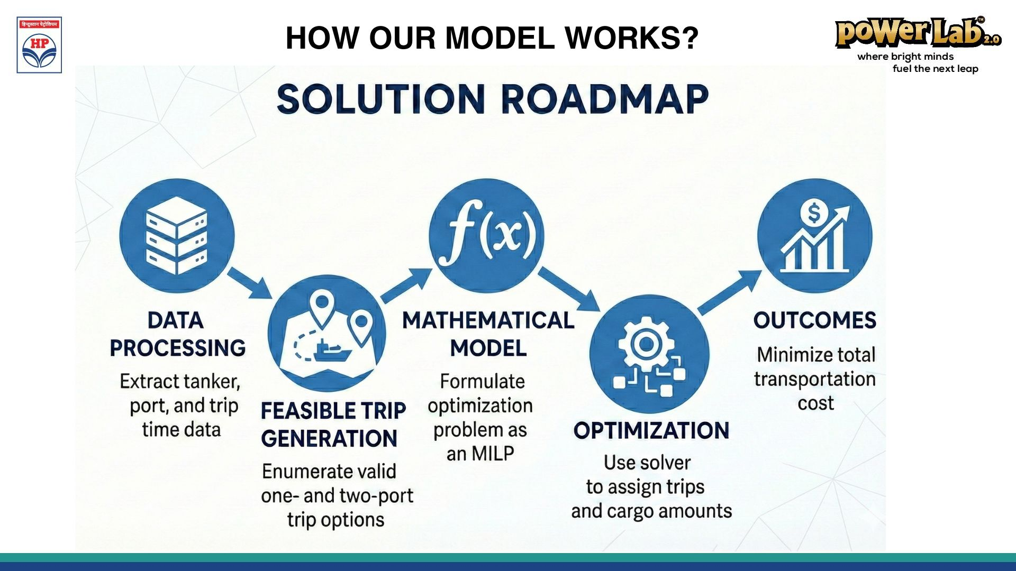
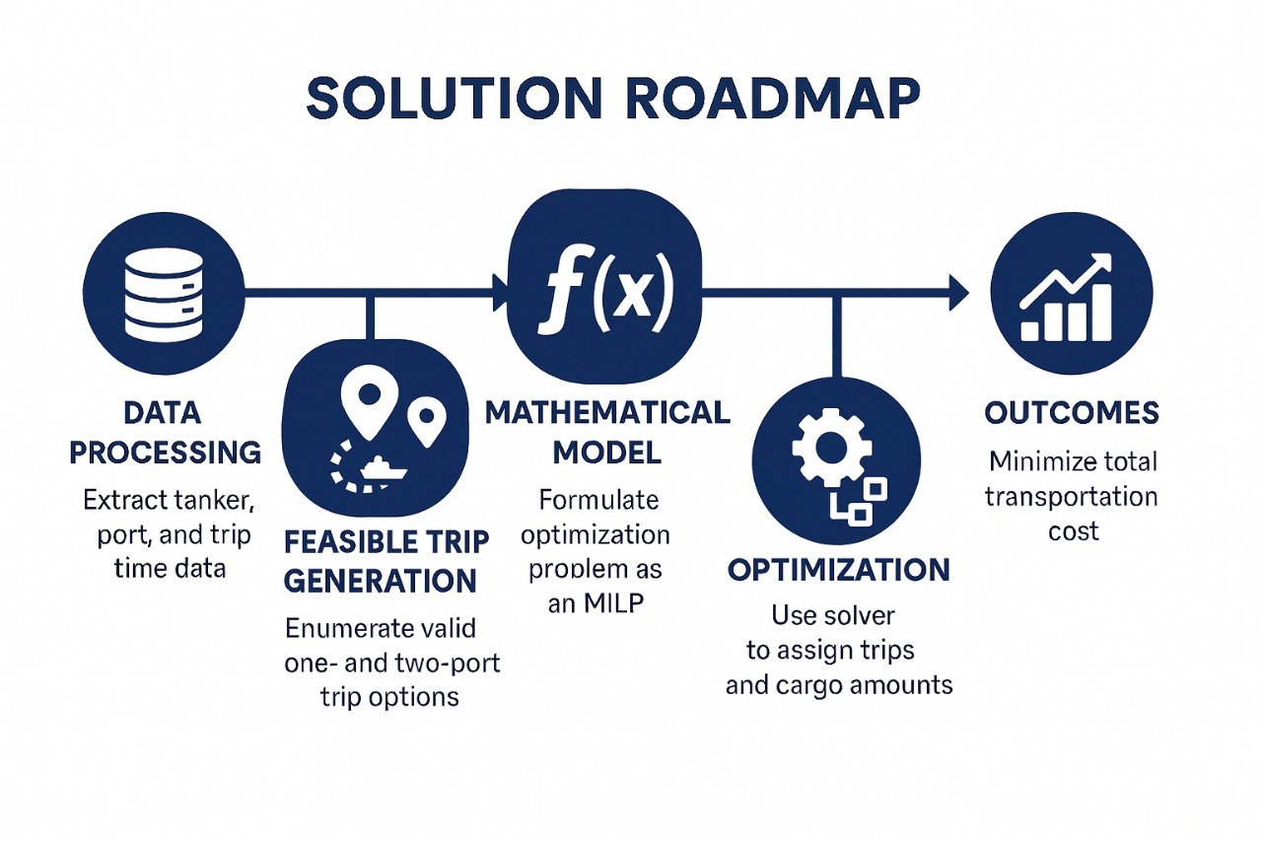
How Our Model Works?

Slide 5
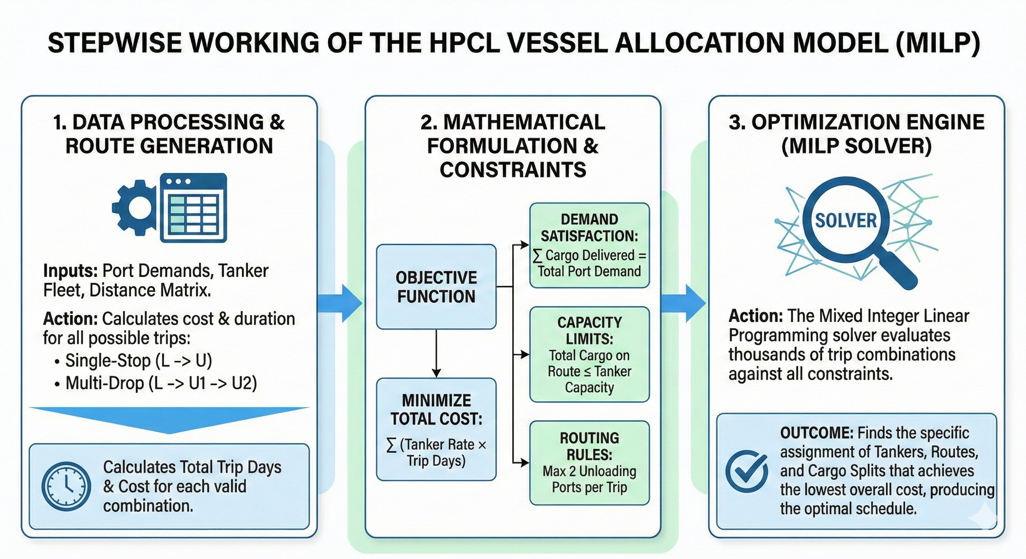
Stepwise Working Of the MILP Model For Optimizing Vessel Allocation:

Slide 6
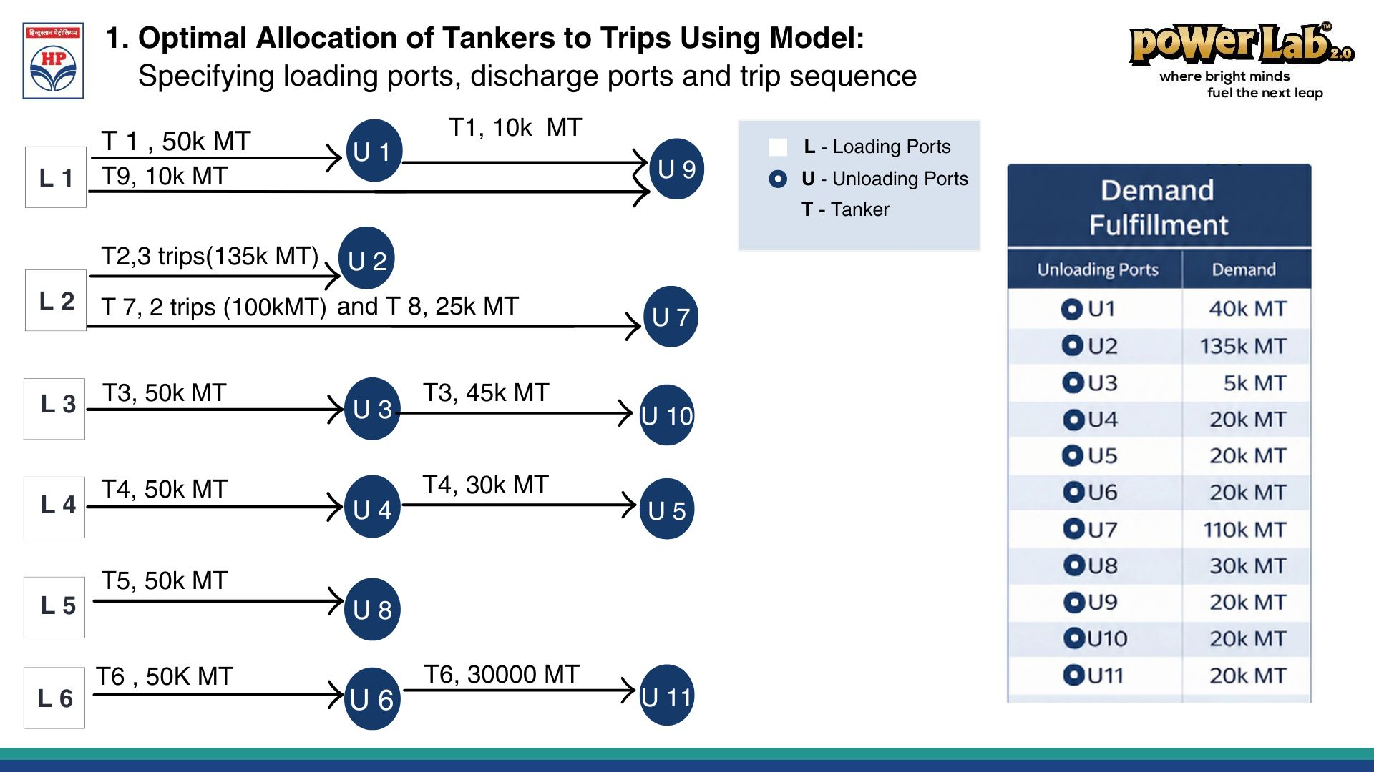
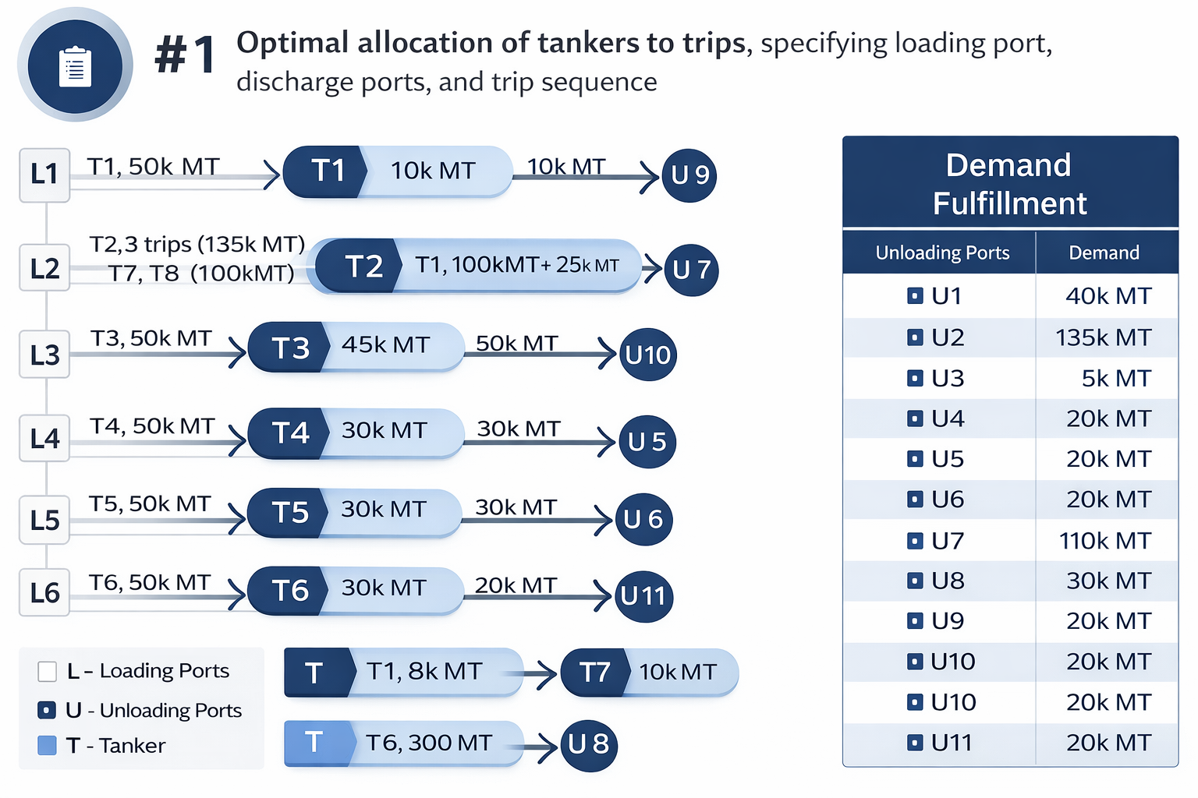
Optimal Allocation of Tankers To Trips Using Model: Specifying loading ports, discharge ports and trip sequence

Slide 7
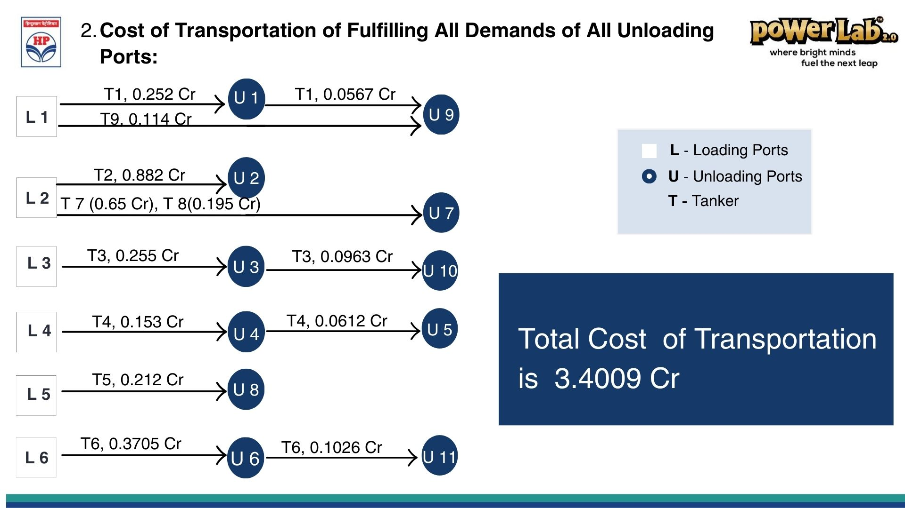
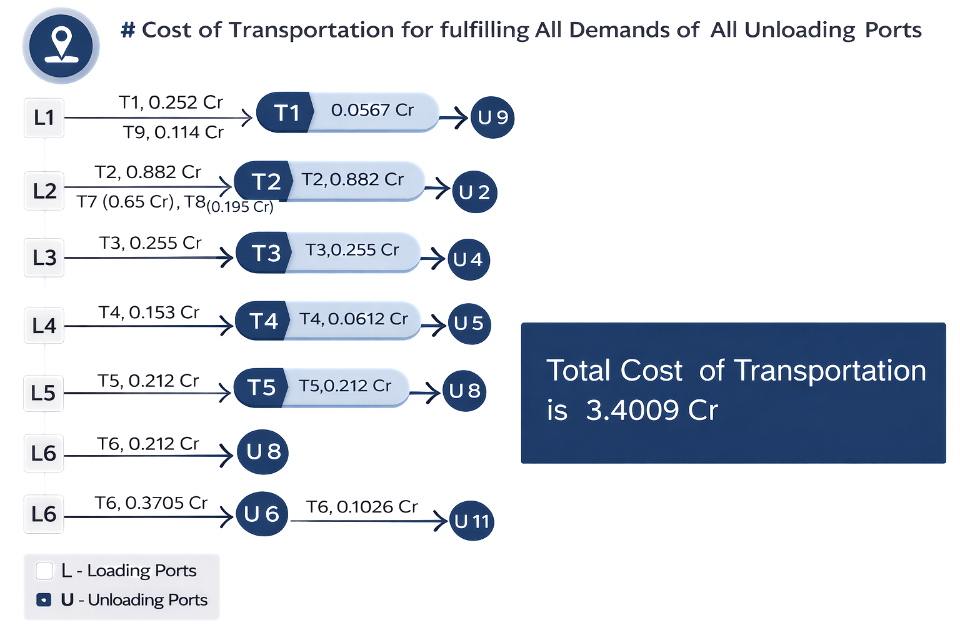
2. Cost of Transportation of fulfilling all demands of all Unloading Ports:

Slide 8
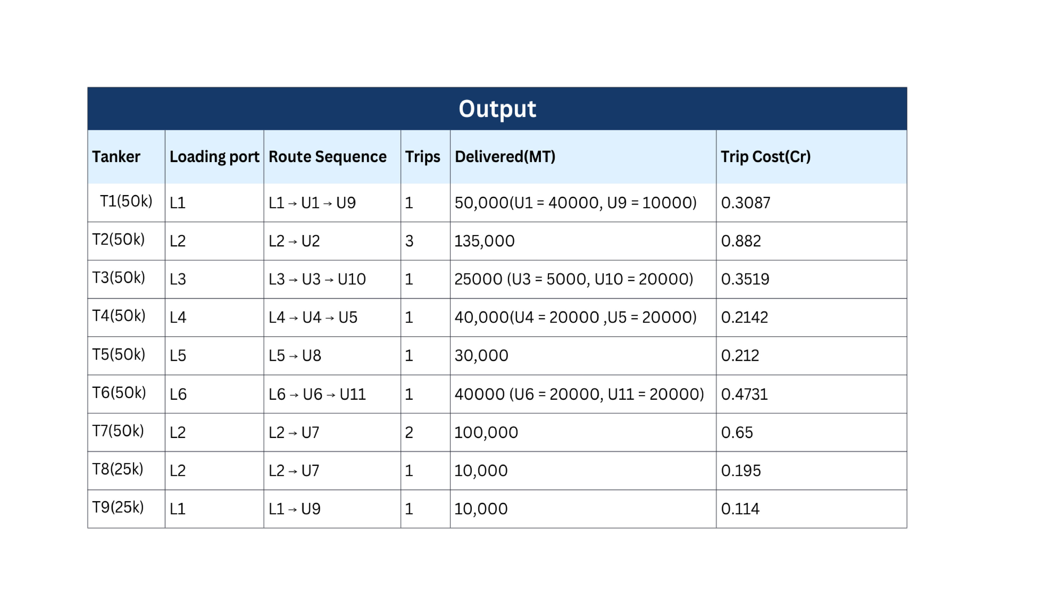
Total Trip Costs(Cr) = 3.4009 Cr
RESULT OF OUR MODEL

Slide 9
Strategic Impact & Business Value
1. Maximized Cost Efficiency:
  Minimum Possible Expenditure: The model successfully identified the lowest cost baseline of 3.4009 Cr, ensuring no budget is wasted on inefficient routing.
  Direct Savings: Achieved a quantifiable decrease in total transportation costs by optimizing charter days and vessel selection.
3. Reliability & Future Growth:
  100% Demand Satisfaction: Guaranteed that every single metric ton of demand (455k Total) across all 11 unloading ports is met, eliminating shortage risks.
  Scalable Architecture: The MILP framework is designed to be a scalable solution, ready to adapt for future fleet expansions or new port additions.
2. Operational Excellence:
  Precision Allocation: Replaced manual scheduling with a mathematically optimal plan that assigns specific tankers (T1-T9) to exact routes.
  Asset Optimization: Ensured efficient utilization of the fixed fleet of 9 tankers, balancing high-capacity (50k) and lower-capacity (25k) vessels effectively .
4. Clearer Logistics Planning:
  Loading Ports: Where to pick up fuel (L1–L6).
  Discharge Rules: Precise instructions on whether to make a single stop or a multi-drop delivery.
  Trip Frequency: Exactly how many trips each tanker needs to make to meet the quota.

Slide 10



thank
you

